Slide 1
Product Sales Data Project
SQL-Based Analysis on Sales Performance

Slide 2
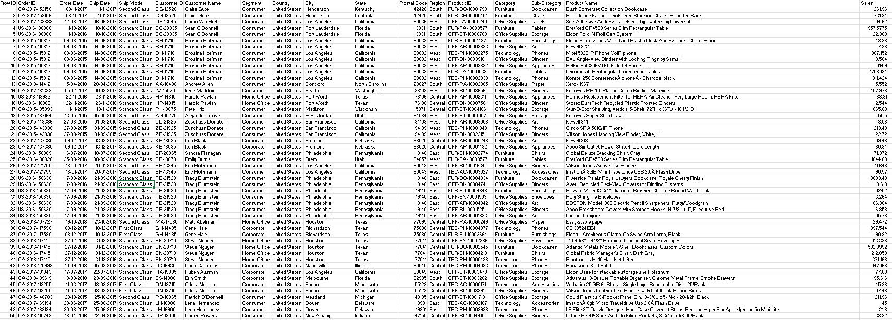
Raw Data

Slide 3
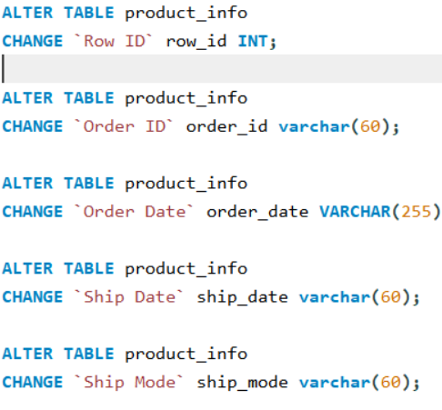
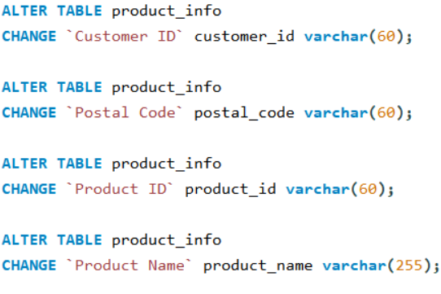
Rename The Columns

Slide 4
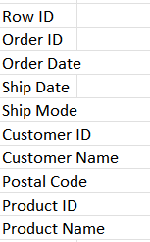
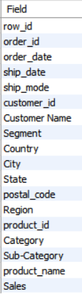
Before And After Rename

Slide 5
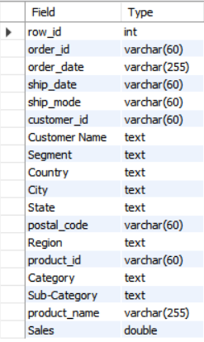
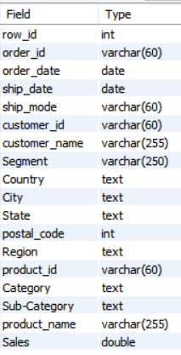
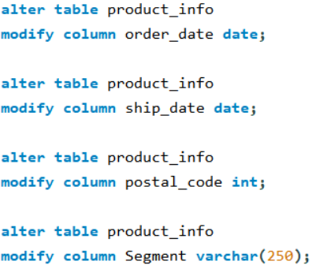
Changing Data Types

Slide 6
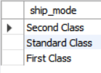
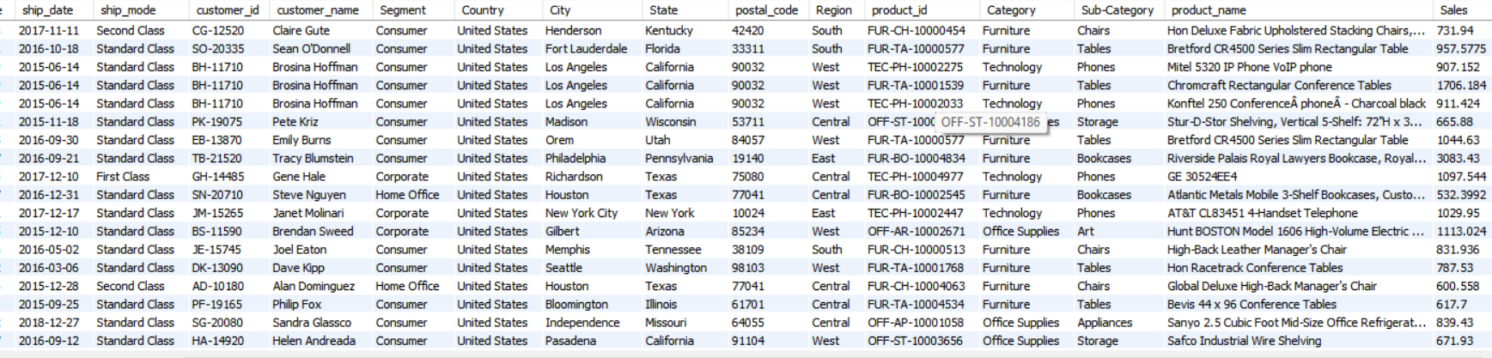
1.Show only unique Ship Mode types
select distinct ship_mode from product_info;
2.List all orders where Sales > 500
select * from product_info
where sales > 500 ;

Slide 7
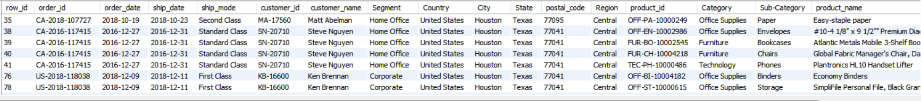
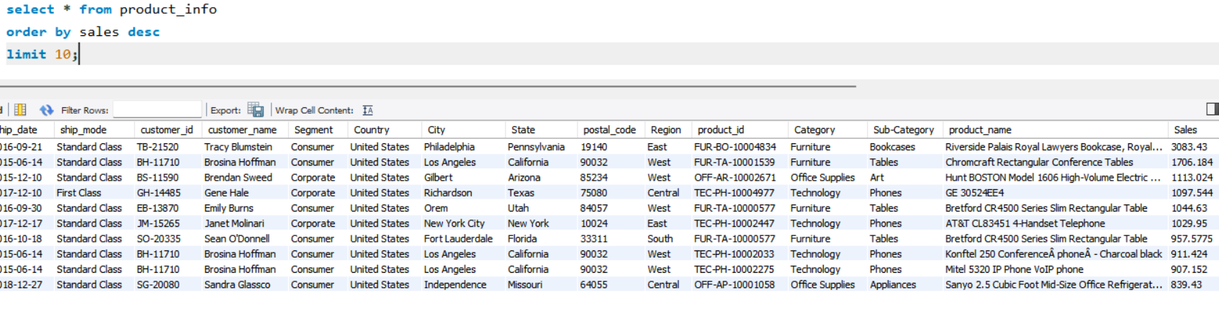
3.Orders from a specific city or state
Select * from product_info where city = "Houston" ;
4.Top 10 orders with highest sales.

Slide 8
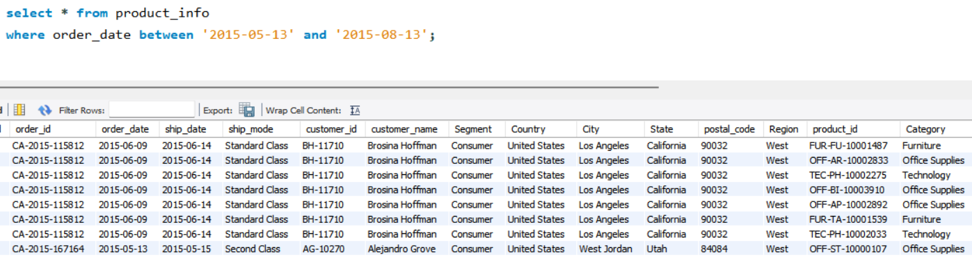
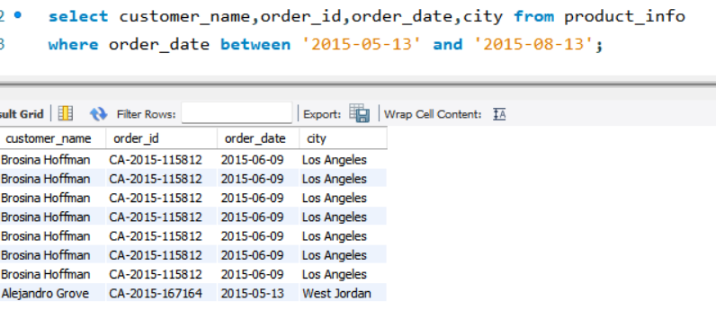
5.Orders between two specific dates.
Additional query :- who ordered 0rders between two specific dates for which cities.

Slide 9
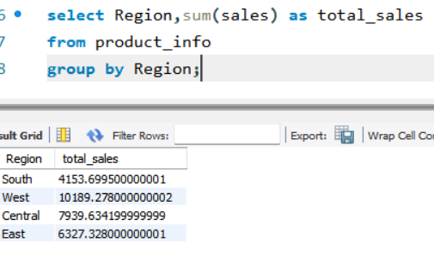
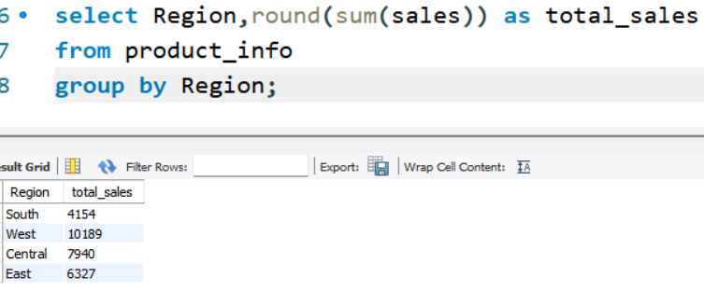
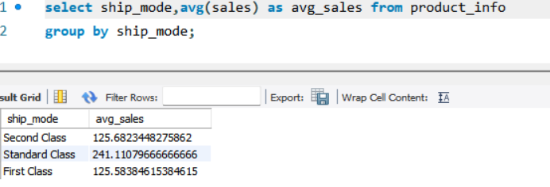
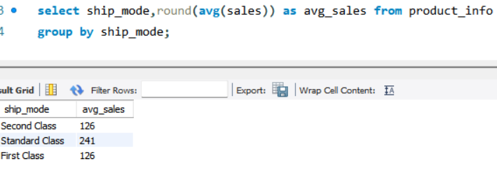
6.Total sales by Region.
Additional query :-Total sales by Region with rounded values
7.Average sales by Ship Mode.
Additional query :- Average sales by Ship Mode with rounded values

Slide 10
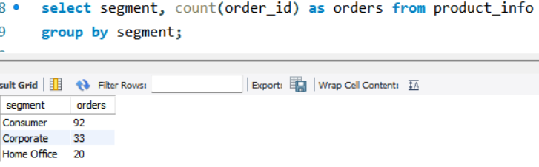
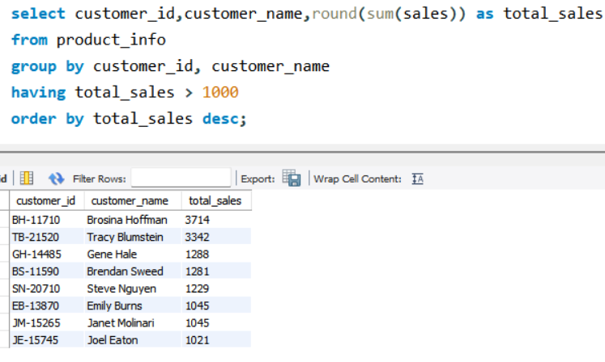
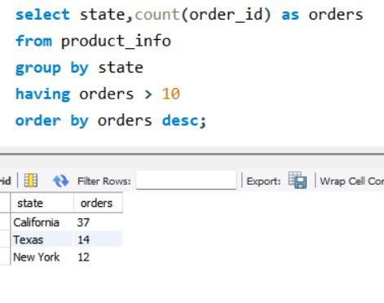
8.Count of orders per Segment.
9.Customers with total sales above 1000.
10.Number of orders per state, showing only states with more than 10 orders.

Slide 11
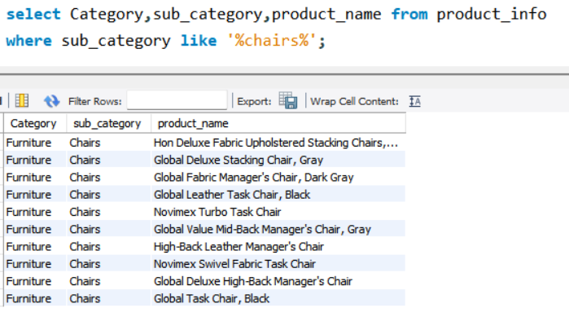
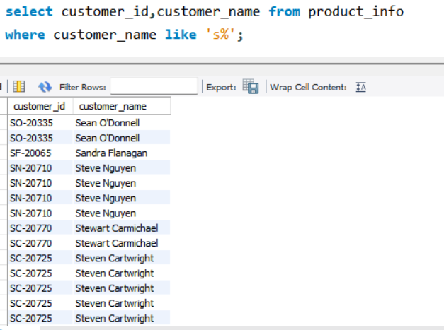
11.Find products that contain the word “Chair”.
12.Customers whose names start with “S”.

Slide 12
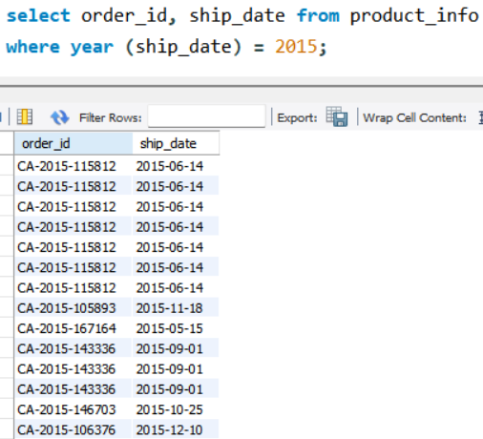
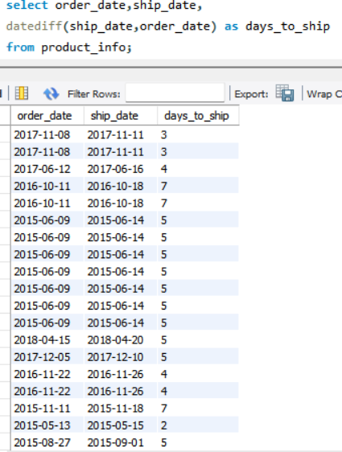
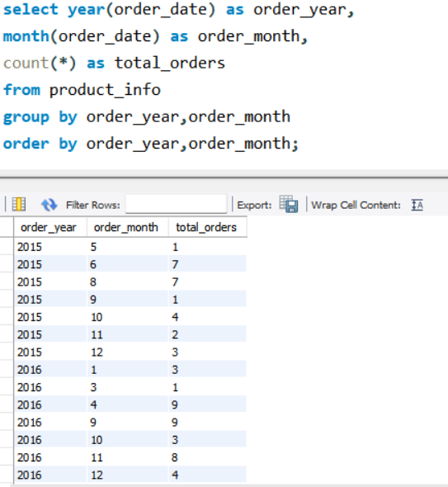
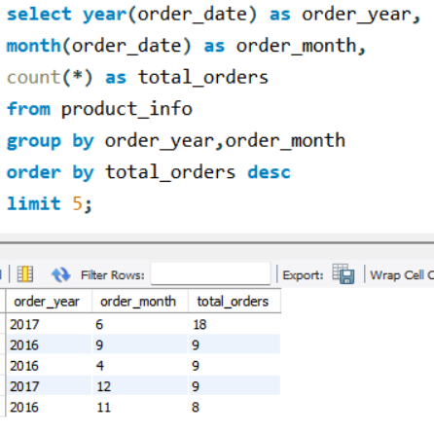
13.Orders shipped in 2015.
14.Days between order and ship date
15.Count how many orders were placed each month.
Additional query:- Top 5 orders placed in a month & year

Slide 13
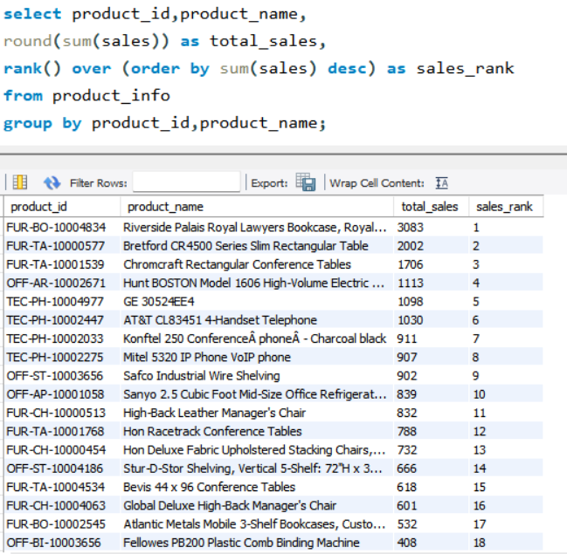
16.Rank products by total sales.

Slide 14
Project Summary & Key Insights
Data: 9800 sales records with customer, order, product, and shipment details
Insights:
- Most orders were placed in 2017
- 'Chair' products are among the top-selling
- West region contributed the highest sales
- Several customers have total sales over ₹1000
Tools: MySQL Workbench, Excel, PowerPoint

Slide 15
Top 5 SQL Queries Visualized
Top 10 orders by sales – highlights biggest transactions
Total sales by region – West region leads
Count of monthly orders – peak in November
Products containing 'Chair' – high-frequency in sales
Customers with sales > ₹1000 – key high-value clients

